Slide 2

HEART DISEASE DIAGNOSTIC ANALYTICS

Slide 3
BUSINESS OBJECTIVE
Health is real wealth in the pandemic time we all realized the brute effects of covid-19 on all irrespective of any status
Hence the health and medical data need to be analysed for the future preparations for better future preparations
It is required to perform ETL(Extract-Transform and Load) and EDA(Exploratory Data Analysis) through python
Hence, it is decided to develop a KPI dashboard to determine key metrics and show meaningful relationships between attributes
This will help to develop insights generated from dashboard for better health preparation by understanding the attribute relationships

Slide 4
PROJECT SCOPE
Medical health data identified for analysis
Clean and transform data as per requirement
Create a health analysis dashboard that measures key metrices
Add relevant filters to slice and dice the data
Dashboard should have key metrics and factors and show the meaningful relationships between attributes

Slide 5
SOLUTION APPROACH
There is 1 table with health details(age, heart health condition, pressure, cholesterol)
Python was used to execute EDA (Exploratory data analysis) and determine correlation between different attributes
Power BI was the tool used for creating the visualization/dashboard
Data was imported, analyzed and transformed using Power Query

Slide 6
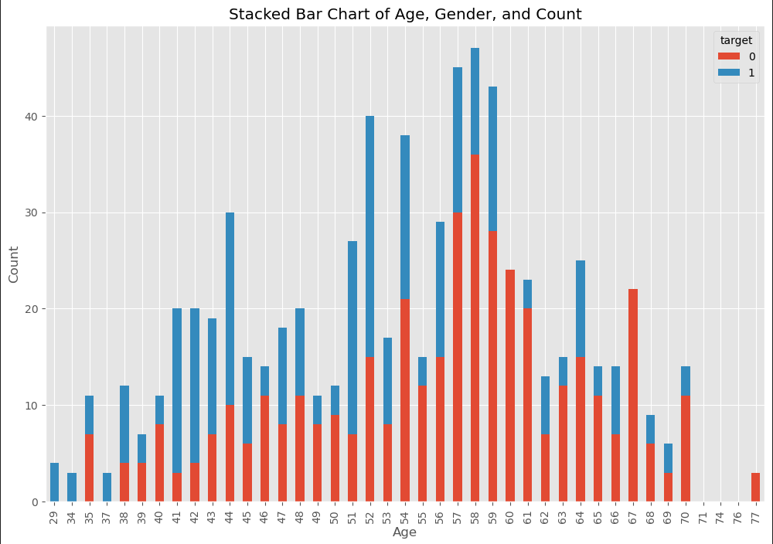
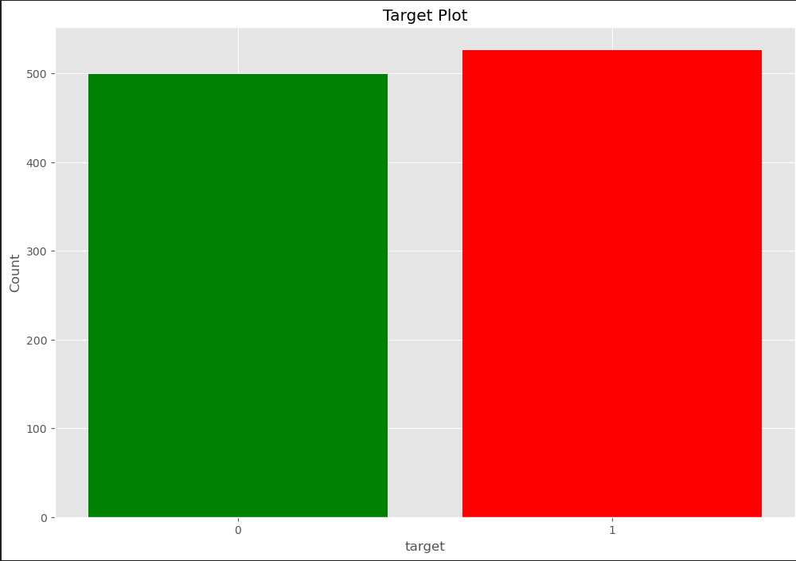
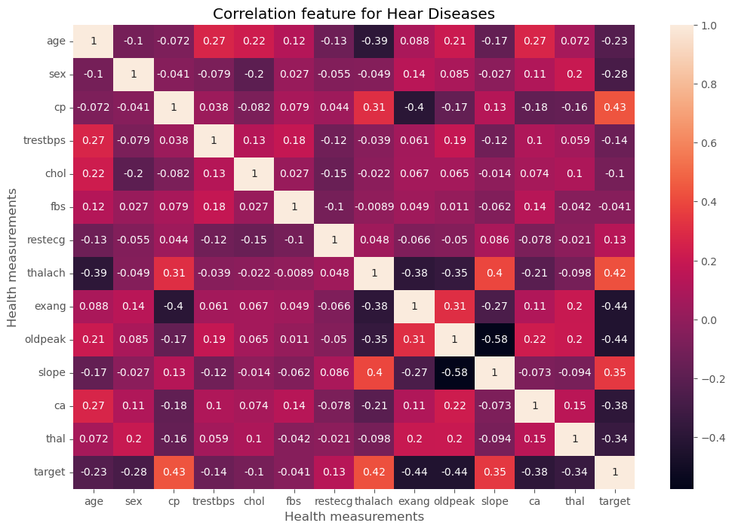
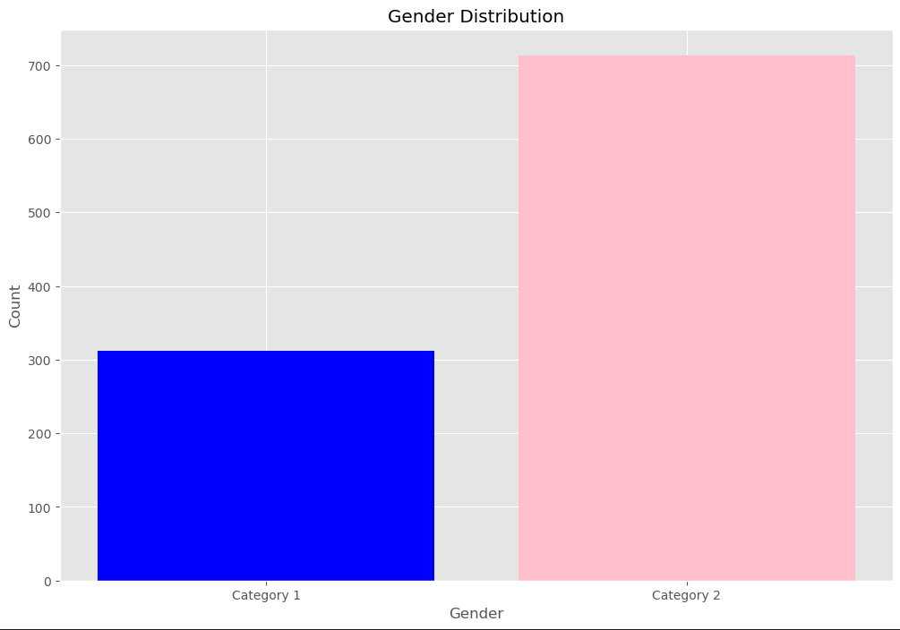
EXPLORATORY DATA ANALYSIS

Slide 7
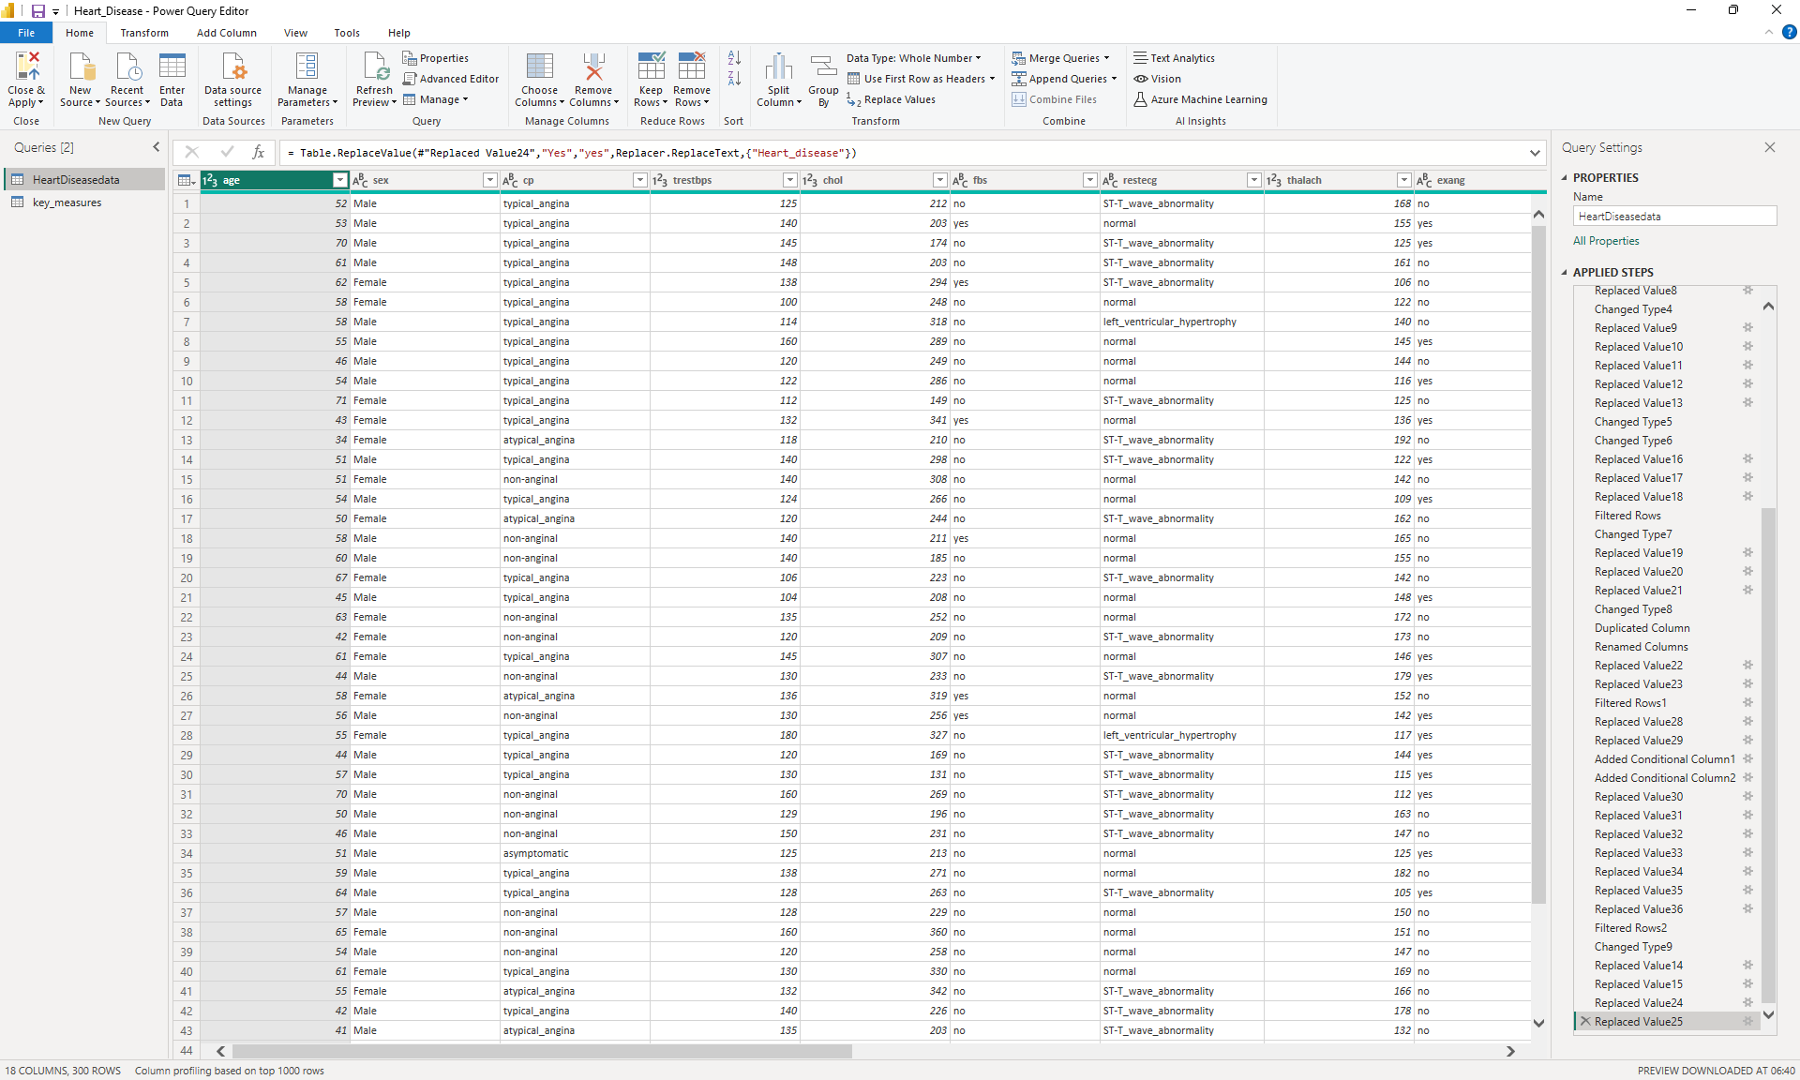
DATA CLEANING / TRANSORMATION IN POWER QUERY

Slide 8
SOLUTION APPROACH
A few measures were created to calculate the KPIs as shown below:
Average Heart Rate = Average heart_rate from the table
Average Blood Pressure = Average of blood pressure reading from the table
Average Cholesterol = Average of all the cholesterol reading from the table
Heart Disease = Total number of people with heart disease

Slide 9
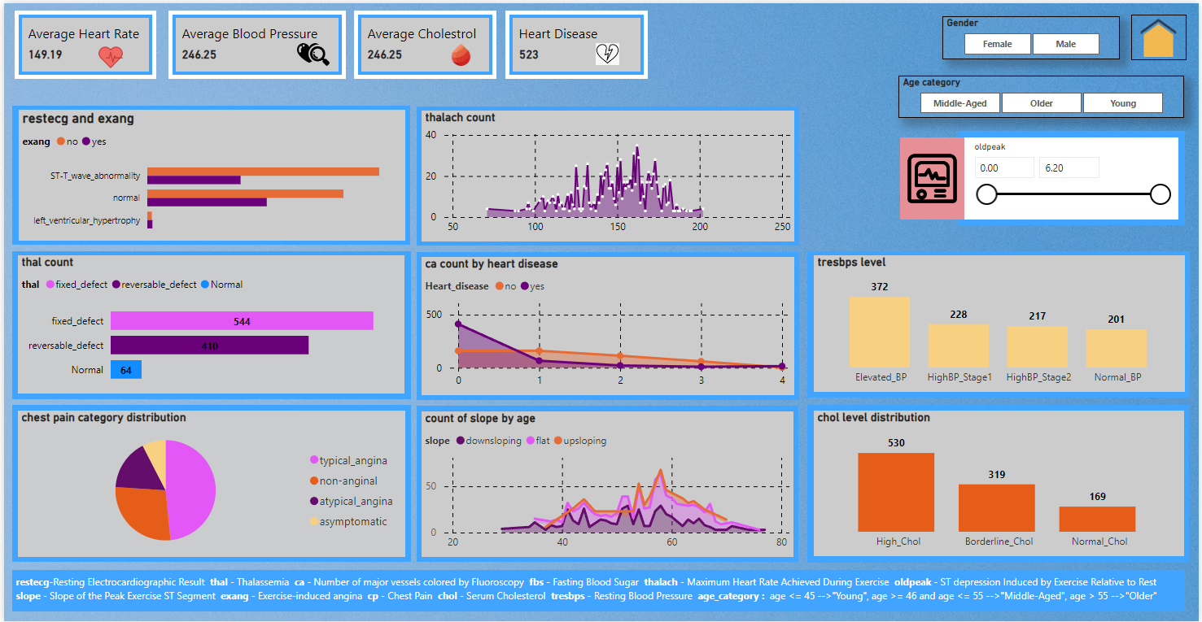
HEALTH ANALYSIS DASHBOARD

Slide 10
DASHBOARD FEATURES
The following 7 visuals were provided:
restecg and exang = Bar chart shows the relation between restecg (resting electrocardiograph) and exang (exercise induced angina)
thal count = Bar cart shows the count of each thalassemia type
chest pain category distribution = Pie chart shows the chest pain distribution type
thalach count = Area chart shows thalach count with thalach(maximum heart rate reached) reading

Slide 11
DASHBOARD FEATURES
The following 7 visuals were provided:
ca count by heart diseases = Area chart showing the ca values (0,1,2,3,4) by the count people effected by heart disease
count of slope by age = Stacked area chart showing different type of slope over the age
tresbps level = Bar chart shows the count of bp distributed over the each type of bp category
chol level distribution = Bar chart shows the count of cholesterol distributed over the each type of cholesterol category

Slide 12
DASHBOARD FEATURES
There are three card visuals in top of dashboard to show the values of important KPIs
The following filters were added to properly slice and dice the data:
Gender
Age category
Old peak
The theme of the dashboard is based on the domain
The visuals are interactive in nature

Slide 13
ANALYSIS OUTCOMES
Heart Disease Prevalence: Over 50% of the sample population is affected.
Chest Pain Types: Typical angina (48.43%), non-anginal (27.6%), atypical angina (16.4%), asymptomatic (7.56%).
Cholesterol Levels: High (51%), borderline (31.1%), normal (16.5%).
Heart Disease Correlation:
45.7% of those with high cholesterol have heart disease.
58.6% of those with normal cholesterol have heart disease.

Slide 14
ANALYSIS OUTCOMES
Resting ECG & Exercise Angina: Combined Indicators of Heart Health
Normal Resting ECG can still show Exercise Angina, indicating potential underlying heart issues.
Left Ventricular Hypertrophy: Both Resting ECG and Exercise Angina typically show abnormalities.
Thalassemia Patients: Fixed/Reversible Defects
Higher Cholesterol and Borderline Blood Pressure levels are common.
Gender Disparity: Males are more frequently diagnosed with heart disease compared to females.
Age Factor: Majority of heart patients fall within the older and middle-aged categories.

Slide 15
CONCLUSION
A health analysis dashboard was built for understanding the various factors depending the heart disease determining its various KPIs
Relevant filters was provided for proper interactions in the dashboard
This dashboard can be used for both high-level and in-depth analysis of KPIs across various attributes of the samples data

Slide 16
THANK YOU !

